Slide 1

LA AYMTAN
(Till WHEN)
Executive SUMMARY
The Lebanese Dilemma, from A to Z…
In all Honesty…
Yet with All the Love…
Dr. Marc ACHKAR
© 2021
Author contact details: +961 3 50 42 45; markashkar@hotmail.com

Slide 2
I- MISCELLANEOUS TOPICS TO TACKLE
1- Old and Modern History Schools
2- Country and Nation
3- Confessional Community / Religion / People / Sect / Creed - Doctrine / Rite / Liturgy
4- Integration / Admixture / Mingling
5- Specificities and Non - Integration
6- Interconfessional Mingling
7- Socio - Economical Level and Education
8- Pact and Binary Equal Sharing, Nationality, and Collective and Personal Identities
9- Christianity and Islam
10- Centralized Government Issue
11- Secularism
12- Genetics in Lebanon
13- Lebanon
14- Canaanites (aka Phoenicians)
15- Arabs
16- Lebanese Christians
17- Lebanese Muslims
18- The Maronites
19- The Rums
20- The Main Personal Identities in Lebanon and the Coherence of Each
21- The Lebanese Vernacular
22- The Canaanite Alphabet
23- Criticizing Far - Fetched Approaches which Lead to Surreal Solutions for the Lebanese Dilemma
A- Settling for Administrative Decentralization as a Unique Concept for the Solution
B- Settling for a Modification of the Electoral Law as a Unique Concept for the Solution
C- Abolition of the Confessional Political System
24- Answers to FAQs Concerning the Practical Aspect of a Federal Order
A- Lebanon’s Area Unable to Sustain a Federal Order
B- Possibility of War between Cantons
C- The need to Go Through Administrative Decentralization
D- The Fact that Federalism Promotes Isolationism and Prevents Confessions from Mingling
E- Federalism Will Oblige Minorities to Migrate to Regions of Concentration of their Own Confessions
F- Federalism Will Lead to Partition
Conclusion
Epilogue
The Proposal for Implementation of a Federation in Lebanon in Practice
TOPICS TO TACKLE

Slide 3
Old History School
Much subjectivity despite objectivity
Much copying from previous historians
Not much basis for sorting information as to reliability

Slide 4
Modern History School
Quasi - objectivity
Criticizing everything from previous historians
Besides archaeology, based on manuscripts, scientific facts, technological development and genetics, to evaluate reliability
Seeks to establish links with international universities
Questioned and adjusted many theories.

Slide 5
Country or Nation
The nation is an area where a sociologically homogeneous people (a nation) practices its freedom according to its identity; it is also called a “homeland”.
The country grants citizenship (also called nationality, a misnomer). It can correspond geographically to the homeland.
The homeland is for a people / a nation regardless of a citizenship.

Slide 6
Religion / Confessional Community / People / Sect / Creed - Doctrine / Rite / Liturgy (1)
Religion: a belief pertaining to creation of the universe and its function as well as eschatological issues, among others.
Confessional community:
- Endowed (in the Middle East) with the definition of a People
- Although technically it should be employed to differentiate communities of a same religion (sects) who do not admix in practice (in daily life) due to confessional issues.
- Synonym to “sect” at the religious level, that is when setting social life aside.
People (social, and not administrative, definition):
- Community that has a same collective identity, collective memory and a homogeneous response to major political events.
- may have one major religion, and it includes irreligious members.
- Usually has a sole mother tongue, that may not necessarily be unique to it.
- Habits, customs, a cuisine, clothing… that do not necessarily arise from religious teachings.
- Often erroneously called “confessional community”.

Slide 7
Religion / Confessional Community / People / Sect / Creed - Doctrine / Rite / Liturgy (2)
Sect / Creed - Doctrine:
- Group within a religion, who has a peculiarity within the general doctrine or creed.
- Sects that do not socially admix form “confessional communities” at the social level.
Rite / Liturgy: grossly synonymous
- Each sect has its rite / liturgy
- Even if sometimes in common languages ​​(for example the Maronite rite is like the Syriac Orthodox or Catholic in terms of language, in Syriac language (currently in Arabic for the Maronites in practice)).

Slide 8
Integration / Admixture / Mingling
Integration: = "homogeneous". When two or more peoples (defined in a social and not an administrative sense) integrate, it is no longer possible to distinguish them at the cultural level; pluralism no longer exists.
Admixture: (disregarding admixture in the biological sense) co-existence within the same region between two (or more) entities of a same people: for example, confessional communities (as per the definition above), or tribal communities... or of two peoples (defined socially and not administratively).
Mingling: compulsory contact between two peoples (defined in the social and non-administrative sense) which are one people at the administrative level (e.g.: the administratively Belgian or Swiss people), which obliges the two peoples to mingle.

Slide 9
Specificities and Non - Integration
We cannot speak of "liberalism" and therefore of sentimental integration if the individuals concerned do not give up their confessional belonging and its sentimental specificities (thus including the cultural - civilizational aspect) and organize themselves within their own social framework, which actually never happened up till now.
Spontaneous non - integrational elaboration would not have occurred if it were not the only way to maintain a free and effective presence in relation to the geographical, historical and political frameworks that we are addressing, and which gave rise to various communities based on sectarian - cultural - civilizational specificities manifesting themselves in the details of everyday life, and sentiments towards political events, the purpose of these sentiments and ensuing attitudes being to preserve the presence of oneself.
→ any statement that calls everyone to live "his religion" at home and to integrate with others into society is a waste of time and effort, especially since one wonders within whom should one integrate? Into another confession? Or in a new atmosphere that does not exist today that could be imported from the West, for example? The two cultures should co - exist.

Slide 10
Interconfessional Mingling
➔ Lifestyles truly meet in many points between different confessional communities.
These points are common to the Lebanese as one people at the administrative and legal levels, given the chronic coexistence between two cultures.
These points are practically, besides the Arabic language of which we will not point out the details of imposition, a certain Canaanization of the Muslims of Lebanon both at the collective and individual levels.
Even the absence of anything in common as to daily life should not be a deterrent to the establishment of fraternal relations.
This meeting of lifestyles at a supra - individual or familial level is not exceptional, but in addition it is a fundamental issue in the daily life of the Lebanese.
But the convergence of the ways of life, be it minimal or maximal, is not the specific criterion for the establishment of the identity of a human collectivity.

Slide 11
Socio - Economical Level and Education
Raising the socio - economic level: including a proper educational curriculum (if accepted by all), can extract the majority of people from a negative extremist state, since said extremism often finds a fertile ground in areas or neighborhoods of low socio - economical level.
This rise will never affect sentimental affiliation, which is evident in societies (and says who that one must try to suppress that belonging).
Sentimental belonging: unifies among members of any confessional community, regardless of the socio - economic level of its individuals, and we do not see any existential obsession among members of a same particular community based on the socio - economical level

Slide 12
Pact and Binary Equal Sharing, Nationality, and Collective and Personal Identities
National Pact of 1943 consecrating Christian - Muslim duality.
Taef Agreement of 1989 introducing binary equality.
Collective Identity: All that is due to the Lebanese citizen's most important identity remaining his social identity, to which he is more spontaneously sentimentally affiliated than to his belonging to the Lebanese Republic or Greater Lebanon via his nationality (citizenship).
Coexistence and the intercommunal relations and the fraternal relations between members of different communities: these depend on the personal identity of the citizen _ and not on his collective identity which protects him from an unwanted integration_ which gives him a certain margin, wide or narrow, to interact with individuals or groups from other communities.

Slide 13
Christianity and Islam (1)
1) The Belief:
Christianity is a belief that concerns the creation of the universe and its course and eschatology (e.g., the existence of a god, Jesus of Nazareth is the son of God, he is resuscitated).
Islam is a belief that concerns the creation of the universe and its course and eschatology (e.g., the existence of a god, Muhammad bin Abdulla is "The Prophet" of God, every occurrence is pre - written by God (al - maktoob)).
2) The Request:
Christianity is a call to follow a behavior that promotes peace, according to Jesus of Nazareth as told in the Gospel, emanating from excessive rational love, and an invitation to preach it alongside belief.
Islam is an obligation to establish the reign of God in terms of justice as the doctrine advocates it, even if by force (Jihad).

Slide 14
Christianity and Islam (2)
3) The Condition to Be Conform:
A Christian is quasi - surely a sinner, but can never be treated as an infidel.
→ It is thus possible for a Christian to be liberal, moderate, conservative or fundamentalist in his practice of rituals and vocation, all those categories being included in the basic doctrine.
Islam: The five pillars: the "Testimony" (there is no god but "Allah", and Muhammad is the prophet of "Allah"), pilgrimage, fasting, zakat (10% of income to the poor) and the 5 daily prayers. And the "Testimony" does not ask, but requires adherence to the dictates of the Koran, those of the hadiths (speeches) of Muhammad bin Abdullah and those of his biography, and so it is possible for a Muslim to atone for another Muslim on the basis of a non-adherence.
→ Therefore, a Muslim cannot be liberal, moderate or conservative in the way he practices his religion and even more his obligation, without being at risk of being accused of being outside the main doctrine, and therefore at risk of being called a disbeliever

Slide 15
Christianity and Islam (3)
4) Concerning Secularism:
Secularism is at the heart of Christian doctrine. As soon as it mixes religion and state, Christianity deviates from its doctrine.
The rejection of secularism is at the heart of Muslim doctrine. Islam is religion and state via a political system within a Muslim state. As soon as it separates religion and state, it deviates from its doctrine.
5) Concerning Worldliness (Imposition of a Certain Culture):
Christianity does not impose (or propose for that matter) a certain culture (a worldliness).
Islam imposes a certain culture (a worldliness): it must change the core of the people that embrace it (thus apart from the practice of rituals) by removing it from its nationalism and its culturo - civilizational current, because Islam is religion and worldliness (and state, all three).
This is carried out by the "Shariaa" (law) based on the Koran, the prophetic hadiths (speeches) and the biography of the prophet, to manage the world, that is to say the details of daily life and how to live it.
Of note, current nationalisms within Muslim countries are a "failure - until - now" for Islam.

Slide 16
Christianity and Islam (4)
6) Concerning Religious Obligations:
Christianity is not "Messianic": it does not consider that it is the duty of Christians to ensure the salvation of the world. They must preach (through their daily life or devote it to proselytism), and the preached are left at ease.
Islam is Messianic: it is the duty of Muslims to ensure the salvation of the world by carrying out the implementation of God’s will, and more, reign. They must preach (through their daily lives or devote themselves to proselytism) (they call their preaching “da`wa (da3wa)”, and the preached are not left at ease, but "jihad" is obligatory (when deemed feasible).

Slide 17
Christianity and Islam (5)
7) Some struggles pertaining specifically to Islam, thus besides struggles common to both religions:
The abrogating and abrogated verses (Median and Meccan verses respectively) (about 350 verses) (whereby the former prevail if circumstances allow. And among the Medinian, the verses concerning Jihad, and those that define infidelism and punishment, and the punishment of apostates);
The question as to the reliability of every single "hadith" (speech) of the prophet (their number being 1,400,000 speeches)
The refusal of Islam to criticize itself to go towards certain amendments since any criticism means a criticism of the Word of God;
The "fatwas" (advisory opinion of the Sheikhs); the "legal duties" (taklif shar3i) (religious request that is supreme to personal choices and even to the administrative laws of the country).

Slide 18
Centralized Government Issue
It turned out that the formula of the centralized government (meaning unitary state) had exhausted all chances of solving the Lebanese dilemma and had even made things worse, which is understandable because the unitary state did not conform to the reality of the heterogeneous People.
Then came the attempt to apply consensual democracy within this unitary state, which paralyzed what was still working.

Slide 19
Secularism
Can encompass several points of view and types.
It is NOT a political order like federalism.
The hostile type is separation of religion and state.
The friendly type is disestablishement (separation of clerics from state); the country can still have a religion and promulgate religious laws should its civil representatives wish.

Slide 20
Genetics in Lebanon
As a summary, the Canaanites of the year 2000 BC are almost identical to today's Lebanese, who are clearly distinguishable from other Levantines, and that percentage is at 93%. As reported in the American Journal of Human Genetics on July 27th, 2017, "Biblical Canaanites" did not disappear; they weren't replaced. They transmogrified, but here they are (biologically).
Additional studies can be performed to sort out the genetic pool of Muslims that were implemented in Lebanon since the Muslim conquest, as per reliable manuscripts. However, bearing in mind that the classification of Peoples should, at least for us, be social and not genetical, such studies are not needed to solve the Lebanese dilemma.

Slide 21
Lebanon
"Greater Lebanon" (synonym to the Republic of Lebanon): is geographically almost identical to the historical "Land of Lebanon".
Lebanon (land of Lebanon): is a geographical region defined simultaneously topographically and climatically: it is the region that appears elevated and white for several months of the year.
There was never a social entity called "Lebanese" back then. The term "Lebanon's identity" is erroneous. Lebanon was totally (up till the Muslim conquest) inhabited by Canaanites (not to mention a tiny percentage of foreigners due to occupations and cultural exchange).
→ it may be said that "Lebanon's identity" was totally Canaanite up till the Muslim conquest.

Slide 22
Canaanites
The Canaanites are a people that have existed with their civilization for 5500 years, and that was confined within Lebanon (in its historically known extension and which conforms to Greater Lebanon to 95%) since 1190 BC.
Formed a stable civilization with which they entered the Byzantine sphere via Christianity, and then part of them had to enter the orbit of Arabo - Islamic culture, exiting at that moment the culturo - civilizational Canaanite sphere.
Were successively called Phoenicians (Punics in the West) and Aramaics, then those of besieged Mount Lebanon by the Muslims called themselves Lebanese in 676. Yet the latter will be known as Maronites since ~ 900 (as well as Syriacs since ~ 550), while Christian minorities around Mount Lebanon will be known as Rums (since 742).

Slide 23
Arabs
There is no Arab reference claiming an explanation of the term "Arab” in an acceptable manner for all those who claim Arabism.
Muslim dogmatists : Any Arabic speakers are Arabs.
Most non - scholar Muslims: Anyone who speaks Arabic and who is Muslim in terms of belief, or heritage only, or Bedouin without the belief, is an Arab. Because Arabism in terms of civilization is inseparable from Islam. And the term "nationalism" itself with its current meaning is not present in the lexicon of the Arabic language, but was created for this meaning in about the mid - nineteenth century“.
Scientific definition: Pre - Islamic tribes of the Levantine / Arabian desert, including Sham / Anbar deserts down to east Jordan and mid and east Saudi Arabia (+ gulf coast); excluding Hedjaz / Yemen. The only people to have been totally incorporated into Islam as culture, besides religion. Thus they do not exist anymore as a social entity, yet as Muslims, they retain their language and Bedouin culture.
Christians: It is not clear to us neither to themselves on what basis some consider themselves Arabs, but is understood that this is brainwash since they are told that they speak Arabic, live in Arab countries, etc...

Slide 24
Lebanese Christians
Thus nowadays, 89% of Lebanese Christians are actually Canaanites (in terms of "People").
> 99.9% of Lebanese Christian descendants of the diaspora are genetically speaking of Canaanite origin, albeit most now perhaps no more Canaanite at the social level.
Said "scientifically", here the conclusion of biology and social sciences.
As for the 11% who are of Armenian, Assyrian, Chaldean, Syriac and Coptic origins, they have blended within the Lebanese Christians, even if conserving their own “ethnic” peculiarities, and thus they are socially Canaanites as well, just like any Lebanese - American, who is an American, with Lebanese peculiarities.
All those Christians became Lebanese since 1920 from administrative / legal point of view.

Slide 25
Lebanese Muslims
100% of Lebanese Muslims are actually Muslims (in terms of "People") (and who might wish for various reasons to be specifically labeled as "Arab - Muslims").
Said "scientifically", here the conclusion of social sciences.
Genetically a mix of those Canaanites who splintered and became Muslims (more than as to a religion, but as to a People) and those Muslims who were transferred to Lebanon.
Despite their integration all together when it comes to "Muslim v/s Christians" matters which is all the more supported by the adoption of a binary system in 1943 despite 18 "confessional communities", they have not admixed in practice, thus still much often referred to by the “confessional community” appellations: Sunni, Shiite, Druze.
They have all borrowed irreligious habits and customs from the "Christians", habits and customs which are now erroneously labeled as "Lebanese", but which are actually "Canaanite", whereby Canaanites did not disappear but have evolved into current "Lebanese Christians".
All those Muslims became Lebanese since 1920 from administrative / legal point of view.

Slide 26
Maronites
A sect (denomination), that due to geographical split up, organized as a confessional community, but they are not a People by themselves.
Fate wanted Maronite monks from north western Syria to preach the pagan Canaanites of Mount Lebanon, so they became Maronites and exploited geography and resisted, so they were not at all subjugated to the Arab - Muslim entourage, neither to Syria (Bilad el - Sham) nor to more distant entities.
Syriacs are a People from northern Mesopotamia. Their language dominated Christianity and dominated Canaanite (called back then Imperial Aramaic) and infiltrated north western Syria at the literary and liturgical levels. This is how "Saint Maron" and his disciples came to use the Syriac language, with which said disciples brought Christianity into Mount Lebanon.
Gradually inhabitants of Mount Lebanon adopted the Syriac language as literary instead of Canaanite, on top of it being their liturgical language. This is why they will be labeled as Syriacs. Used Roman and Greek for political purposes.

Slide 27
Rums
A sect (denomination), that due to geographical split up organized as a confessional community, but they are not a People by themselves.
Fate wanted that the apostles and disciples of Jesus of Nazareth preach directly the pagan Canaanites of the Coast, the South and the Bekaa, and then they followed the (imposed) Greek liturgy since 328, and eventually became Rums (we hereby mean religiously, since 742).
Their regions were subjugated to the Muslim conquest given the accessible geography, and thus those who remained Christians were subjugated to the entourage and co - existed with it through mandatory Dhimmism.
Yet they remain socially integrated at the sentimental level and even more so, admixed at the civilizational, communitarian and social levels, with the Maronites, as per what we see today on the ground.
Used Roman and Greek for political purposes, and Greek for science and philosophy, in addition to Canaanite, all that till the Muslim conquest, when Arabic was enforced.

Slide 28
The Main Personal Identities in Lebanon and the Coherence of Each
Compatibility / Confusion / Contradiction | Believer or Atheist | The Lived Worldliness (Collective Identity) | Legally (Administratively)
Compatibility | Believer in Islam | Muslim Worldliness (with a strand of Arabism) | Muslim
Religious Confusion# | Believer in Islam | Muslim Worldliness Atmosphere but sprinkled with an external strand (specifically in Lebanon a Canaanite strand^) (with a strand of Arabism) | Muslim
Practical Identitarian Confusion* | Atheist or religion not coupled to a worldliness | Muslim Worldliness Atmosphere but sprinkled (more than here above) with an external strand, specifically in Lebanon a Canaanite strand^) (with a strand of Arabism) | Muslim
Compatibility | Atheist or religion not coupled to a worldliness | Canaanite | Muslim
Contradiction# | Believer in Islam | Canaanite | Muslim
Compatibility | Atheist or religion not coupled to a worldliness⁺⁺ | Canaanite** | Christian

Slide 29
The Lebanese Vernacular
(Spoken) "Lebanese" is not a language, nor an Arabic dialect.
It is a variety of the Canaanite language, in its current evolved form, which also includes Syrian and Palestinian varieties.
The "Lebanese Canaanite" variety is actually two varieties: "Ordinary Lebanese Canaanite" variety, mainly spoken by the "Christians", and "Arabized Lebanese Canaanite" variety, mainly spoken by the Muslims, each englobing different regional and communitarian dialects.
Each dialect is further divided into accents.

Slide 30
The Canaanite Alphabet
It fell in disuse after Arabic and Syriac replaced Canaanite as literary languages (again, not as spoken languages) among the Lebanese Christians.
It can be easily updated for vowels, as well as lacking consonants. We have proposed such an update, as well as a keyboard and a font to that aim, and typed a paragraph on MS Word that we will include below as an image because there is still the limitation of the font having to be installed to view said paragraph as text.

Slide 31
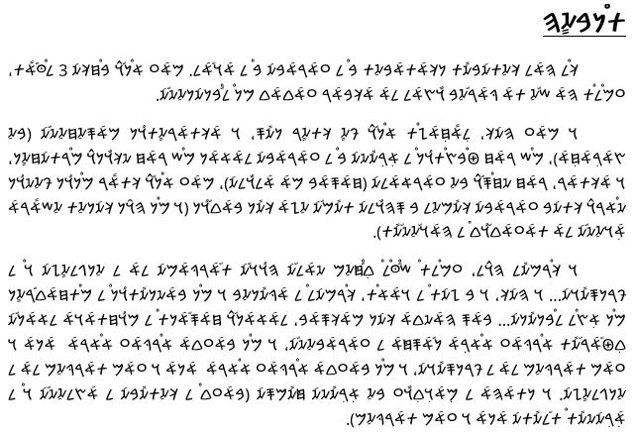

Slide 32
Criticizing Far - Fetched Approaches which Lead to Surreal Solutions for the Lebanese Dilemma
A- Settling for Administrative Decentralization as a Unique Concept for the Solution
Administrative departments will remain completely devoid of the necessary constitutional powers which protect them from being subject to the legislation of the Central Parliament, decisions of the Central Cabinet, and considerations of the judicial system of the central authority.
Indeed, the conflict manifests itself in its political, legislative, executive, security, economic, legal, cultural and administrative aspects.

Slide 33
Criticizing Far - Fetched Approaches which Lead to Surreal Solutions for the Lebanese Dilemma
B- Settling for a Modification of the Electoral Law as a Unique Concept for the Solution
Under any electoral law, confession will remain the main source of inspiration for voters, and this will produce the same parliamentary structure as is today.
In the case of proportional elections within a unitary state, there will inevitably be a parliament that will be subject to a majority, even if only by a slight difference... in other words, it remains subject to the rule of the “stronger counterpart”.
Federalism is a complete political system, in which electoral reforms of proportionality or others can be applied.

Slide 34
Criticizing Far - Fetched Approaches which Lead to Surreal Solutions for the Lebanese Dilemma
C- Abolition of the Confessional Political System
Any suggestion of secularism in a unitary state will counterbalance the popular sentimental background and produce either a breakup of the state, or the creation of a malicious system allowing the largest community to "legitimately" control the entire power of the government by itself via demographics.
“Sectarianism" means "belonging to sects" but was derived into "hate on the basis of sects“.
The federal system has the necessary flexibility to allow people to spread the concept of secularism within their confessional societies should they want to.

Slide 35
Answers to FAQs Concerning the Practical Aspect of a Federal Order (1)
A- Lebanon’s Area Unable to Sustain a Federal Order: There are several countries smaller than Lebanon; also of note: Russia: 17,000,000 sq. km, Switzerland: 41,000 sq km: area not a factor.
B- Possibility of War between Cantons: All we be of same military strength,
C- The need to Go Through Administrative Decentralization: No ties.
D- The Fact that Federalism Promotes Isolationism and Prevents Confessions from Mingling: Any current wish to peacefully mingle is considered a prelude to demographic overrun. In federalism mingling is safe.

Slide 36
Answers to FAQs Concerning the Practical Aspect of a Federal Order (2)
E- Federalism Will Oblige Minorities to Migrate to Regions of Concentration of their Own Confessions: Not more than in a unitary system (kindly to ponder upon minorities status), and even less (Constitutional protection as well as through Ombudsman tribunal).
F- Federalism Will Lead to Partition: not unless partition was sought for from the beginning, and call to federalism was a step out of shyness to call upon partition.

Slide 37
Answers to FAQs Concerning the Practical Aspect of a Federal Order (3)
Advantages of Partition and Disadvantages of Federalism:
Partition is the purely scientific solution to the conflict of the Canaanite and Arab - Muslim civilizations (should we ignore exceptions).
Partition allows the Muslims to choose to govern by the "Islamic Laws" and to comply to the letter to the spirit of the "Cairo Declaration of Human Rights in Islam", even within the central authority (option available in the cantons within federalism under some conditions of respect for minorities, the civil Constitution with at least a touch of secularism and the "United Nations Charter of Human Rights" and its other complementary texts being adopted in the central government).
Partition exempts communities from mandatory partial sharing of taxes and revenues through a centralized government.
Federalism demands concessions from Muslims in terms of some convictions considered as being of the foundation of Muslim doctrine

Slide 38
Answers to FAQs Concerning the Practical Aspect of a Federal Order (4)
Advantages of Federalism and Disadvantages of Partition:
Partition requires a final internal migration of minorities with cutting links with original regions, or the minorities accepting the principle of Dhimmism (for Christians as for Muslims, be it religious or civil, since no constitutional protection for minorities).
Hostile (non - friendly) partition by the Christians will lead to them being besieged (or Christians and Druze if they create a federal state) geographically and economically, and will oppress the Druze if these join a Muslim state (unless this state is established on a federal basis).
The success of fraternal relations imposed by time and circumstances, between the members of the confessions, with the desire to mingle despite the civilizational distinction between the duo members and the social distinction of the Muslim confessions, constitutes one of the solid foundations of federalism preference.
Federalism maintains Lebanon as a unique state with all its advantages.
Federalism strengthens communities against foreigners by creating bonds of solidarity.
Federalism ensures the benefits via the cultural and economic links of the communities (with the West as well as with the Islamic countries, including the Arab world) and this point is very important.

Slide 39
Conclusion
We demonstrate that in Lebanon, Canaanites (bynamed Phoenicians, and later included totally or partially in various appellations such as Aramaics, Syriacs, Byzantines, Rums, Arabs and Lebanese) still sociologically exist (and exist in the diaspora) and are current "Lebanese Christians".
On the other hand, we demonstrate that Muslims of Lebanon are part of the worldwide Islamic nation of which a portion considers itself Arab - Muslim, the latter of which a portion lives on the historical land of Lebanon, which is quasi - synonymous to "the Republic of Lebanon" since 1920.
Thus Lebanon is a country that encompasses two Peoples. It has been essentially divided since the conquest, and it was administratively unified in 1920 through a centralized system of governance (a unitary state) that does not take pluralism into account.
Hence, a federation of present - day Lebanon would not be a division, but a union of its two components in a way that would manage pluralism. If that is impossible to achieve, then (pacific) partition is a must for peace.

Slide 40
Epilogue (1)
A unitary political system through a centralized Constitution is set up in 1926.
→ Each law should be applicable on all Lebanese soil, and laws concern major and minor and even trivial issues.
→ A 1943 Pact stating Lebanon to be "of Arab face", considered by Christians a victory since not "strictly Arab", and considered a victory by the Muslim because of mentioning "Arab".
→ A 1958 truce states "no winner, no loser".
→ A 1990 call for binary equality, yet never respected. Of note, Lebanon "becomes" "of Arab identity and belonging".
→ Almost all cultural, sociological and political events are antagonistically interpreted by Christian and Muslims, and by Sunnis and Shiites, as well as the Druzes.
→ Thus said factions fight for seizing power, as the sole means to preserve itself within a unitary system.
→ Other factions will call upon external "sponsors" to rescue them and help them seize power.

Slide 41
Epilogue (2)
Here the feudal / confessional lords step-up: each presents himself as the savior of his own community: corruption is a must for the good of the community.
Despotism is the law, nepotism on the go: he replaces the state as to social services. He (most at least) has his armed wing. And in the back stage, there is always a deal among different lords to perpetuate the issue into and endless loop.
History has been concealed, hence no data, thus no diagnosis, and eventually no plan: and why a plan when a change could jeopardize said lords?
No revolution will take place, but a revolution needs one sole social faction to carry it out: two or more social entities can hardly do it, if ever. The proof: being buried under tons of garbage, then the Beirut explosion… what other explanation to the so called "Lebanese - inertia"?

Slide 42
The Proposal for Implementation of a Federation in Lebanon in Practice (1)
The Proposal for Implementation of a Federation in Practice
It tackles both Peoples' fears, in their believers and irreligious, in their seculars or theocrats, whatever their culture,
It is the system that slows the most any internal displacement,
It tackles change of circumscription, inter-social* (and we shall not say inter-faith since way beyond that) marriages and nationalization,
* We maintain the use of the word "confessions" to ease comprehension
It allows for a quota for ownership, rent, residency and work, promoting mingling will prohibiting isolationism,
It solves social clashes such as week-ends and holidays,
It distributes taxes and revenues in an appropriate manner,
It solves the clashes as to Lebanon's identity as a republic and all internal as well as foreign policies attached to that issue,
It achieves binary equality (and proportionality within Muslims), with rotation as to unique posts,

Slide 43
The Proposal for Implementation of a Federation in Lebanon in Practice (2)
It adopts the Ombudsman tribunal for Human Rights cases, for protection of minorities from any distinctive abuse of their right, whether at the individual or collective level, and for cases of administrative corruption.
It enforces an "escape friendly" secularism in the federal government only, leaving for cantons, the choice, but most important giving a space to call upon said secularism,
It proposes a general optional secular personal status law,
It achieves administrative decentralization,
It allows a national reconciliation, which can lead to:
- demarcation of all borders,
- completing foreign withdrawals,
- returning detainees and deportees, as well as solving the issue of the missing people inside the country,
- expatriates regaining their citizenship and right to vote and reduce the voting age to 18,
- writing History in a progressive, non-classical fashion.

Slide 44
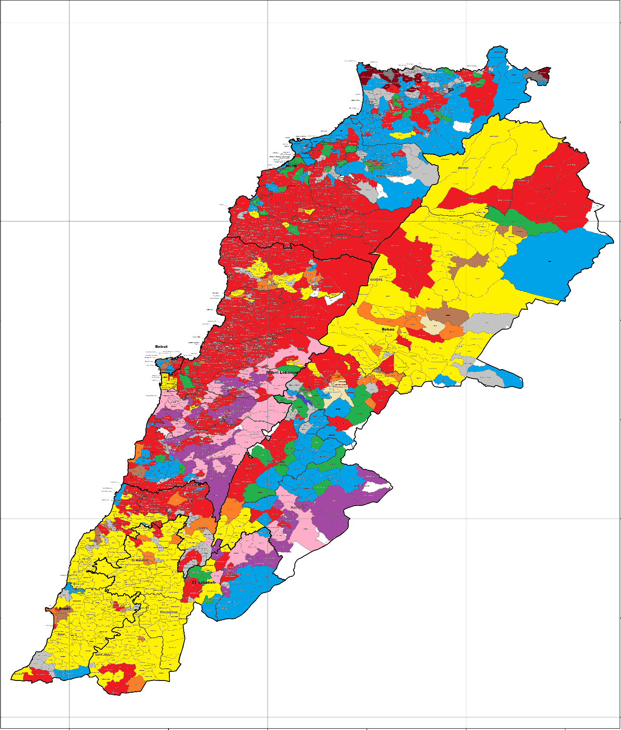
Map “A”: Confessional Demography in 2010

Slide 45
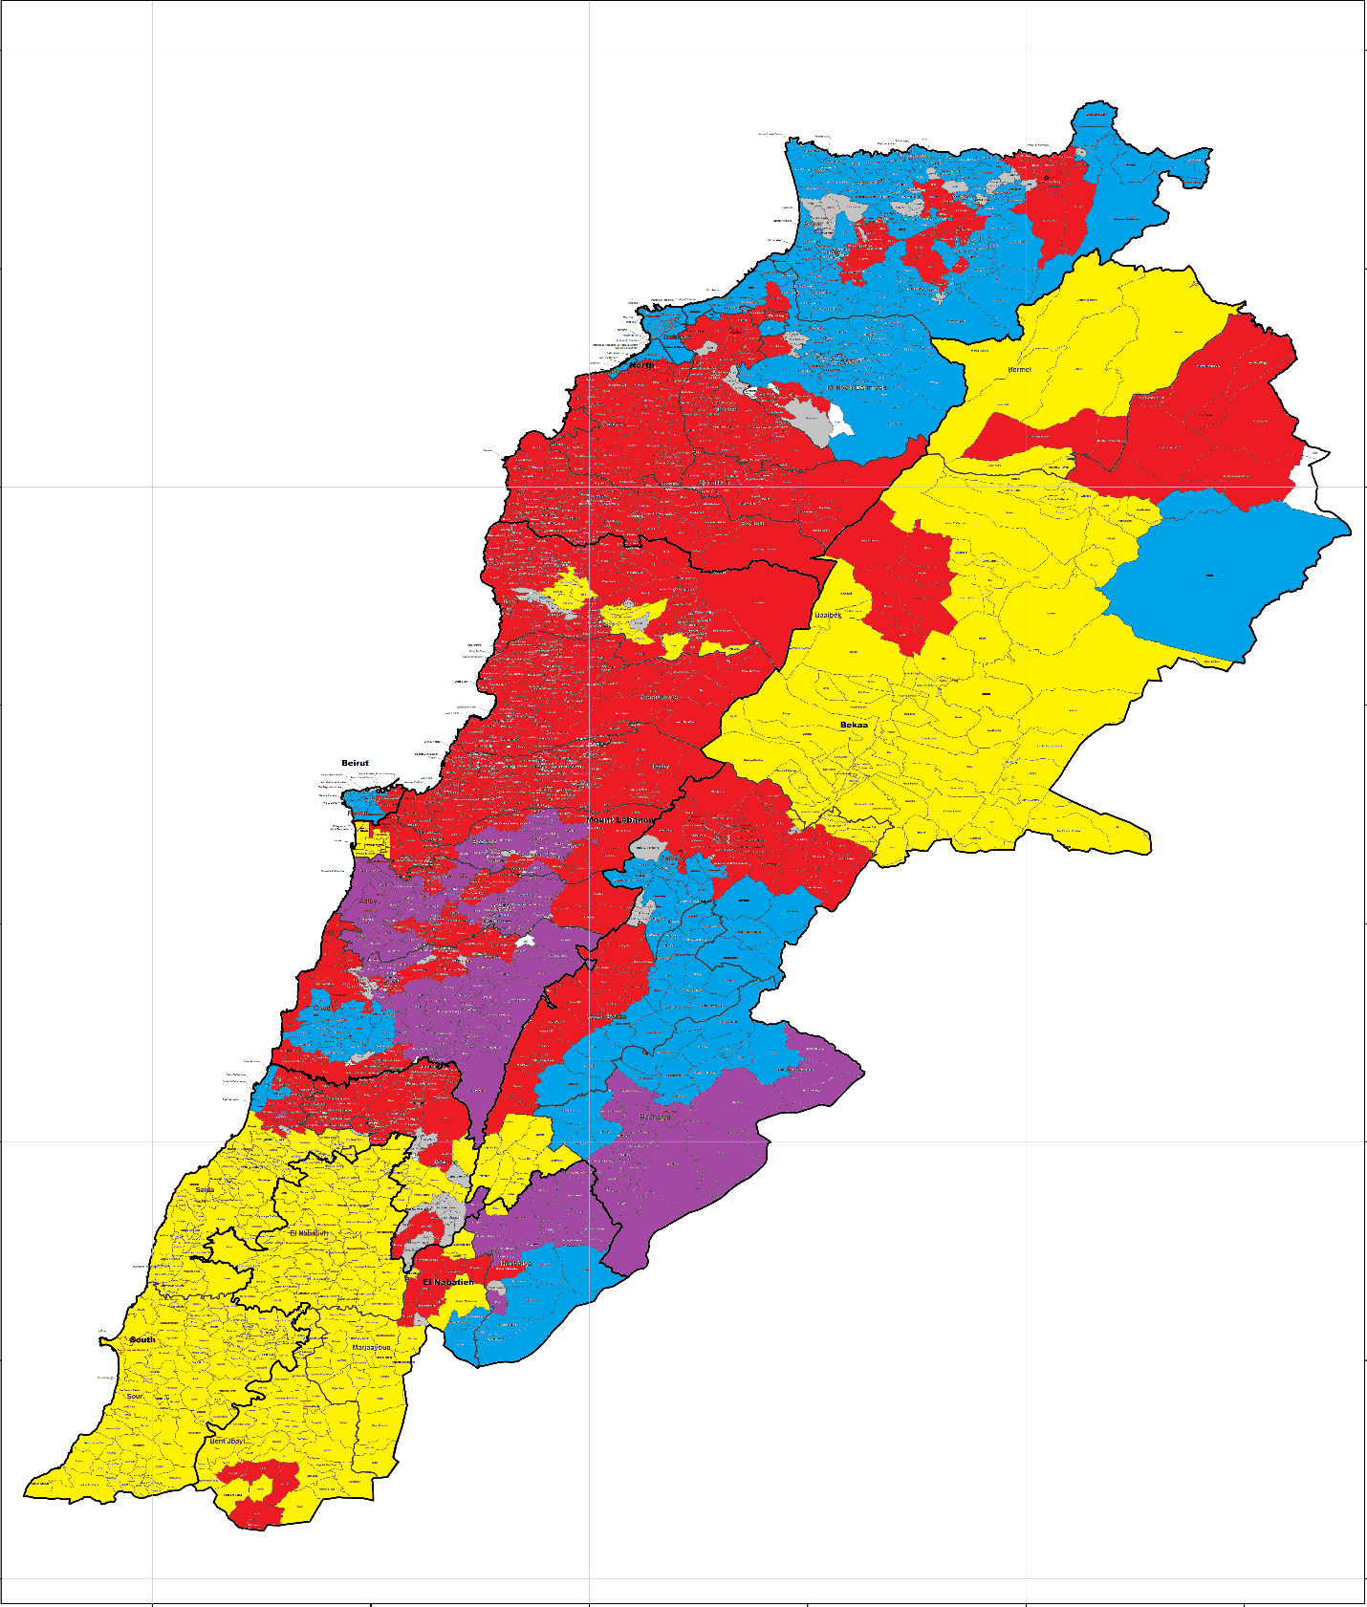
Map B: Proposed Cantonal Map

Slide 46
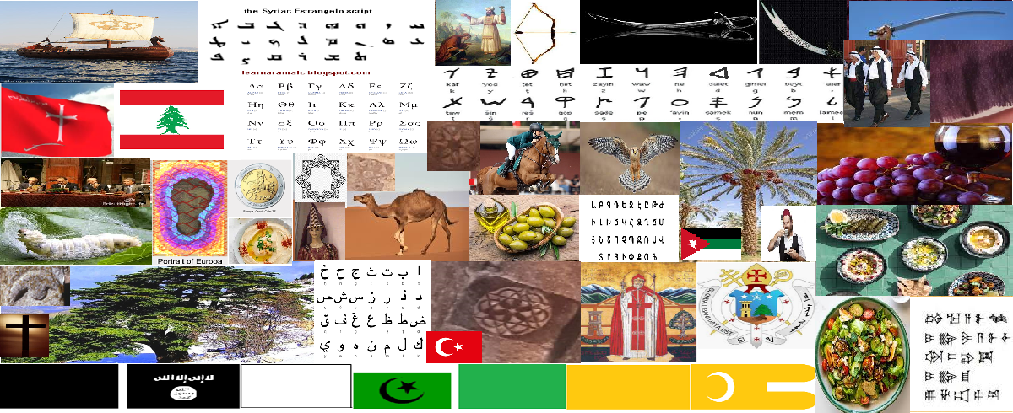
Thank You!

